Slide 1


Isometric Management avi’s video on CD: “old training matls I”
Out of the Box Isometric Extractions
    Enter SmartPlant 3D and switch to Drawings and Reports task
    Right click on plant SP3DTrain, select New.. to create a Folder
    Rename the new folder to: ISOS
    Right click on ISOS, select New.. to create a Drawing By Query Manager from the General tab
    Rename the resulting Drawing By Query Manager folder to Unit01
    Right click Unit01 and select Setup..
    Under Filter select More.. and pick Training Filters>U01
    Under Packages Select More.. and pick Iso Pipeline then OK
    Right click Unit01 and select Run Query

Slide 2
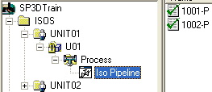
Isometric Management
Out of the Box Isometric Extractions (cont)
    Expand the tree structure created and right click Iso Pipeline to launch Create Drawings
    Right click iso 1001-P and select Update Now
    Once the green check appears, double click drawing 1001-P to review content or
    Right click drawing 1001-P and select View Extraction Data.. To review log, pcf and drawing files
    Repeat procedure to create drawings by query for Unit02 (U02) on a separate folder under ‘ISOS’

Slide 3
Isometric Management
Setup Custom Style
  Define Border and Options Set
    Copy and paste the file Iso_Pipeline.igr file in \\[Server]\Symbols\PmfgIsoStyleData
    Rename the copy UserIso_Pipeline.sha
    Copy and paste the file Iso_Pipeline.XML file in \\[Server]\Symbols\PmfgIsoStyleData
    Rename the copy UserIso_Pipeline.XML
    Uncheck the read only property for the files
    Open the UserIso_Pipeline.xml file using a text editor and use the search tool to change all occurrences of Iso_Pipeline to UserIso_Pipeline
    Save the file

Slide 4
Isometric Management
Setup Custom Style
  Bulkload new style
    Open the file Bulkloadisokeys.xls from [Install Directory] \CatalogData\Bulkload\DataFiles
    Select row 6 (Iso_Pipeline) and right-mouse Copy
    Right-mouse Insert Copied Cells
    Insert a letter ‘A’ (Add) in the first column of the new row
    Change Iso_Pipeline to UserIso_Pipeline in the IsoNames column
    Change OutPutIsoDrawingsLocation to IsoDrawings\UserIso_Pipeline
    Change IsoBackingSheet to PmfgIsoStyleData\UserIso_Pipeline.sha
    Change IngrOption to PmfgIsoStyleData\UserIso_Pipeline.xml
    Save the spreadsheet and close Excel

Slide 5
Isometric Management
Setup Custom Style
  Bulkload new style (cont)
    Start the Bulkload utility using Start → Programs → Intergraph SmartPlant 3D → Database Tools → Bulkload Reference Data
    Click the Add button and add the BulkloadIsoKeys.xls from …\CatalogData\Bulkload\DataFiles
    Change the bulkload mode to Add/Modify/Delete records
    Pick the server, catalog and catalog schema names for the training plant
    In the log file field, select the ellipsis (…) button and click OK
    Click Load to load the new style into the catalog
    Review the log file to make sure there are no errors

Slide 6
Isometric Management
Setup Custom Style
  Create Style Package
    In Drawings and Reports task add a new folder under ISOS called ‘Packages’
    Right-click on Packages folder and add a new Piping Isometric Drawings by Query component
    Rename the component ‘UserIsoC’
    Right click UserIsoC then Setup… and in the Filter field select More…
    Expand the tree to Catalog Filters >Default Filters >SP3D Object Filters >Object Types >Piping and pick Pipelines filter
    In the style field, select the style ‘UserIso_Pipeline’
    Right click UserIso and Save Package as ‘UserIso_Pipeline’ under Isometrics (By Query) tab

Slide 7

Isometric Management
Setup Custom Style
  Test iso extraction
    Switch to Drawings and Reports task
    Right click on ISOS, select New.. to create a Drawing By Query Manager from the General tab
    Rename the resulting Drawing By Query Manager folder to Unit01C
    Right click Unit01C and select Setup..
    Under Filter select More.. and pick Training Filters>U01
    Under Packages Select More.. and pick UserIso_Pipeline then OK
    Right click Unit01C and select Run Query

Slide 8
Isometric Management
Setup Custom Style
  Test iso extraction (cont)
    Expand the tree structure created, right click UserIsoC and launch Create Drawings
    Right click iso 1001-P and select Update Now*
    Once the green check appears, double click drawing 1001-P
    The drawing looks just like it did when extracted using out of the box Iso Pipeline options
    In the following section output will be customized for C size extractions
    *Workaround may need to be applied here in early version 7. Request details from Intergraph if needed.

Slide 9
Isometric Management
New Border/Title Block
  Drawing Controls
    Edit Unit01C’s Options for the User Iso Pipeline style
    Expand Drawing.Controls
    Change DrawingSize and PostScriptSize to ANSI “C”
    Update Unit01C’s drawing 1001-P. A C-size multisheet drawing is created
    Right-click 1001-P to Save-As 1001-P.sha file to folder \\<server>\Symbols\PmfgIsoStyleData\
    Open 1001-P.sha and use File >Sheet Setup, set size to C-Wide
    Use View >Background Sheets to edit the border and title block
    Use File >Sheet Setup, to set Background size to C-Wide
    Use the dwg and MTO graphics as reference for the new border

Slide 10
Isometric Management
New Border/Title Block (cont)
    Once the border and title block have been fitted to the C-size sheet, remove any other sheets besides Backing and Sheet 1, as well as the graphics from 1001-P iso
    Replace old User Iso Pipeline template with 1001-P.sha in: \\<server>\Symbols\PmfgIsoStyleData\UserIso_Pipeline.igr
    Open Excel file BulkLoadIsoKeys.xls from <sp3d>\CatalogData\BulkLoad\Datafiles
    Place ‘M’ on line 6 column 1 of sheet PipeMfgRules to reload User Iso format settings to the catalog, save and exit
    Use Bulkload utility to reload BulkLoadIsoKeys.xls
    Update C-size drawing 1001-P and verify the border and title block changes*. Finish formatting border and labels as a final lab AFTER completing the following labs on D-size format

Slide 11

Isometric Management
Title Block Labels
  Attribute Map
    Edit Options for the Iso Pipeline style in Unit01
    Expand AttributeMAP and add a new row
    Name the new HostAttribute User1, pick ATTRIBUTE21 for the Isogen Attribute and pick the origin as ‘User’
    Expand Labels.DrawingFrame and add a new row
    Pick ATTRIBUTE21 for label attribute

Slide 12
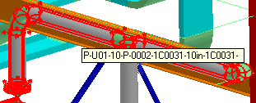

Isometric Management
Title Block Labels
  Attribute Map (cont)
    Pick the catalog label ‘Piping Tooltip pipe run’ as the LabelName
    Pick PipeRun as the OidType
    Expand DrawingFrame.Attributes and add a new row
    Pick User1 for HostAttribute and specify values as below
    Save to catalog
    Update isometric for the pipeline 1001-P in Unit01
    Review the new pipe run label, repeat if needed to relocate label in the title block to new coordinates

Slide 13
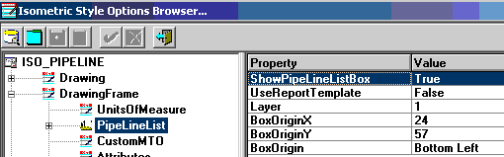
Isometric Management
Title Block
  Line list View
    An Excel LINE LIST table containing the properties of the pipe runs in the pipeline may be placed on the iso at the desired coordinates. Make sure Trust Access to VB is enabled under Excel>Tools>Macros>Security>Trusted Publishers.
    Edit options for Unit01
    Set DrawingFrame.PipeLineList.ShowPipeLilneListBox = True
    Set DrawingFrame.PipeLineList.UseReportTemplate = True
    Verify additional parameters are as shown:

Slide 14
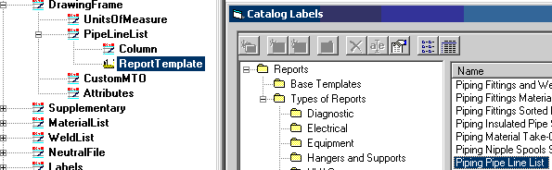
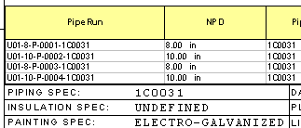
Isometric Management
Title Block
  Line list View (cont)
    For the option DrawingFrame.PipeLineList.ReportTemplate.TemplateName, pick the ellipsis (…) and select the catalog report template from Reports – Types of Reports – Piping – Piping Pipe Line List
    Save options and extract line 1001-P to review the new line list

Slide 15

Isometric Management
Materials List
Several options exist for formatting the material list. In addition to modifying the standard (fixed) material list, it is also possible to use a variable or user-defined material list, where the attributes and their order are specified by the user. It is also possible to use labels to define attributes.
    Edit Options for the Iso_Pipeline style
    Expand MaterialList.VariableLayout.Column
    Fill in values as follows:
    Set MaterialList.VariableLayout.TextSize to Medium
    Set MaterialList.ActiveList to Variable
    Update isometric for line 1001-P in Unit01 and review mtl list
    Adjust heading as needed in MaterialList.VariableLayout.HeaderLines
    Hint: | = End of Line; / = New Line.

Slide 16
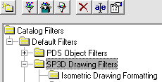
Isometric Management
Format
    The switches in this section refer to the formatting of the isometric drawing. How insulation and tracing are shown, how orientations are shown, how attribute breaks are shown etc.
  Dotted Symbology
    Select Drawing.Format.DottedSymbologyEnable = True
    Select the ellipsis (…) in the Drawing.Format.DottedSymbology.DottedDimensionedFilter field to invoke the Select Filter dialog
    Expand Catalog Filters\Default Filters and create a new folder under SP3D Drawing Filters named “Isometric Drawing Formatting”

Slide 17
Isometric Management
Format
  Dotted Symbology (cont)
    In the new folder, create a new filter and name the filter ‘Dotted Dimensioned Parts’
    On the object type tab, select Piping\Piping Parts
    On the property tab, select More.. to add a new property
    In the Select Properties dialog, select the Construction Requirement property
    Back on the properties tab, select the value ‘Existing’ from the codelist
    Click OK to define the new filter and then select it for the style.
    Save to catalog
    Switch to piping task, select a few parts from the line 1001-P and change their construction requirement to Existing
    Update drawing for 1001-P and review Existing parts on the iso

Slide 18
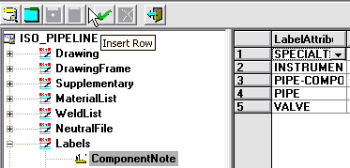
Isometric Management
Labels
Labels are used extensively in SP3D Isometric Drawings. They may be used to output a note on the drawing, determine where an attribute break should occur, gather data for stress analysis etc.
    Edit Options for the Iso Pipeline style in Unit01, expand the tree to find Labels.ComponentNote and then click the green check to insert a row
    In the LabelAttribute2 column, select VALVE, then in the label column, browse to the catalog for the Catalog Labels and pick the Piping> Piping Isometric Valve Tag label

Slide 19

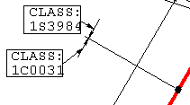
Isometric Management
Labels (cont)
    In the message enclosure column, pick MESSAGE-SQUARE
    Save to catalog and update line 1001-P. You should see the valve tags shown on the iso next to the valves
  Attribute Breaks
    This functionality has two parts: Setting an AlternativeText and supplying a label to get the data for parts.
    Edit Options for the Iso Pipeline style in Unit01. Expand AlternativeTexts and scroll down to ATEXT, notice that the value for -289 is set to “CLASS” for piping spec breaks
    Replace “CLASS” with “MATL” and save
    In piping task, add a piping spec break on line 1001-P
    Update iso of line 1001-P. Spec break should resemble this:

Slide 20

Isometric Management
Labels (cont)
  Attribute Breaks
    The standard attributes are piping specification, insulation specification, tracing specification and painting specification. Whether the breaks are shown on the iso is actually controlled by the AlternativeTEXT values being set or not for each attribute. If the ATEXT value is set to a non-null string, the string is output as a prefix.
    Miscellaneous or user-defined break attributes are set using labels.
    Edit Options for the Iso Pipeline style in Unit01, expand the tree to find Labels.MiscSpec and set MISC-SPEC3 to:
    The ATEXT corresponding to MISC-SPEC3 is numbered -295 Expand AlternativeTexts and scroll down to notice that the value for this ATEXT is set to “CLEAN:”

Slide 21
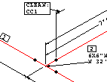
Isometric Management
Labels (cont)
  Attribute Breaks
    Switch to Piping task, select a pipe run on 1001-P and set its Cleaning Requirement to ‘CC1’ (Under “Surface Treatment and Coating” Category)
    Switch back to Drawings and Reports task and update drawing for line 1001-P. Cleaning requirements breaks show as below

Slide 22
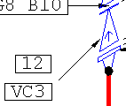
Isometric Management
Labels (cont)
  Conditional Labels
    Sometimes it is desired to output a note on the isometric based on certain criteria. E.g. tags for valves with certain attribute are to be output on the iso but for other valves nothing is to be ouput.
    Edit Options for the Iso Pipeline style in Unit01, expand the tree to Labels.ComponentNoteConditional
    Set the values for the VALVE label row as shown
    Save to catalog and update drawing 1001-P. You will see that a tag is output for the check valves (VC3 in a box enclosure) but not for the other valves. The TestValue and the resulting output label value don’t have to be the same string

Slide 23
Isometric Management
Labels (cont)
  End Connection
    These are special labels that are evaluated for end connections of an isometric. Edit Options for the Iso Pipeline style in Unit01, Select Labels.EndConnection to select an end label
    For evaluating the END-CONNECTION-EQUIPMENT label, the nozzle is passed to the label and the label is responsible for returning the data of interest such as equipment name, nozzle name, and nozzle attributes such as size, end preparation, pressure rating etc.
    For the END-CONNECTION-PIPELINE label, the piping part connected to the last object on the current iso line is passed to the label. It is the label which then retrieves the appropriate continuation item based on the kind of isometric being run
    Extract any iso with eqp or line continuation labels in it to test

Slide 24
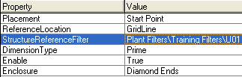
Isometric Management
Dimensions and Coordinates
    Edit Options for the Iso_Pipeline style in Unit01
    Open the switches relating to dimensioning and coordinate outputs found under Drawing.Dimensions
    Set Dimensions.USAStyle to True
    Set Dimensions.ImperialFormat to Space Dash
    Set Dimensions.Overall to Across Branches
    Set Dimensions.ColumnReference.Enable to True
    Set Dimensions.ColumnReference.ReferenceLocation to Gridline
    Set Dimensions.ColumnReference.Enclosure to Diamond Ends
    Set Dimensions.ColumnReference.StrReferenceFilter to U01
    update drawing for line 1001-P

Slide 25
Isometric Management
Detail sketch
  Functionality to show static detail sketches is available. Depending on the part class of the object selected, a specified label is invoked, if the value returned by the label matches the value specified to check against, the symbol is shown on the isometric.
    Open the Drawings Editor in [sp3dinstall]\Common2D\Shape2D\Bin\Shape2DServer.exe
    Start rectangle tool and draw a 50mm x 50mm and angle 0 rectangle
    Using the Text command, place the word DETAIL using Courier New font at 2mm text size at (37, 47) measured from the bottom left corner of the square
    Draw your detail sketch graphics in the square: A pipe hanger
    Create New Symbol using the Create Symbol command
    Place the origin of the symbol in the bottom left corner of the rectangle frame

Slide 26
Isometric Management
Detail sketch (cont)
    Save symbol on \\Server\Symbols\PmfgIsoStyleData directory with name DETAIL116.SYM. Exit Drawing Editor
    Edit options for the Iso Pipeline style in Unit01 and change Supplementary.DetailSketches.Path to be \\Server\Symbols\PmfgIsoStyleData\ (don’t forget the \ at the end)
    Set ShowDetailSketch to True
    Open Supplementary.DetailSketches.SketchMapping
    Change HANGER.SYM to DETAIL116.sym in row 2
    Change SketchChkValue to Assy_VS_SR_DB_116
    Save to Catalog and iso the line 1002-P. A detail sketch for the hanger will be shown on the top right corner of the isometric

Slide 27
Isometric Management
Symbol Mapping
    It is possible to map part classes, supports, welds and end conditions to distinct Isogen symbol keys (SKEY). For part classes, it is possible to specify different symbols for different end conditions (“endpreps”). It is also possible to specify that the same SKEY should be output for all end conditions.
    Extract an iso of Unit 2 (U02) pipeline 2003-P
    The error log contains the following entry:
    Description: SKEY not Found for CSVenturimeter PartClass Identifier not Found. The face of the iso also shows a message to the effect that the SKEY for the CSVenturimeter was not found
    Edit Options for the Iso Pipeline style in Unit02
    Select SymbolMAP and add a new row
    Enter the following values to map the partclass CSVenturimeter:
    Save to catalog and extract line 2003-P. The SKEY error should no longer be reported

Slide 28
Isometric Management
Symbol Mapping (cont)
    It is possible to map individual end conditions (“endpreps”) to distinct Isogen symbol keys (SKEY).
    Edit Options in the Iso Pipeline style in Unit01
    Expand SymbolMAP.Supplement
    Change the EndPrepMap in the row that corresponds to EndPrepCode 21 (RFFE) to CL
    Save to catalog and update line 1001-P. Notice changes at flanged valves, they are actually shown clamped
    Make sure to go back and change mapping back to the original SKEY (FL)

Slide 29
Isometric Management
Custom Symbology
    Functionality is available to re-define the symbol keys supplied with the Isogen software or create new symbol keys in addition to those supplied.
    Install Alias Iso Utilities (click figure to launch):
    Select Start >Programs >Alias Isometrics >Iso Utils >Symbols Editor to launch the Alias Symbols Editing program
    From the drop-down on the ribbon bar, select Redefining Valves
    Select Symbol >New. The Add New Symbol dialog will come up
    Place a check in the Copy Symbol From checkbox
    Click on the browse button next to the Old Symbol Key text box to bring up the Select Existing Symbol Dialog box
    From the dialog box, select the Basic Valve. The dialog will automatically be dismissed.
    Select the browse button and select the 01SP spindle key

Slide 30
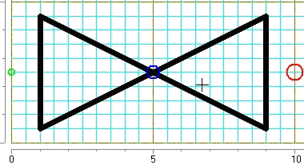
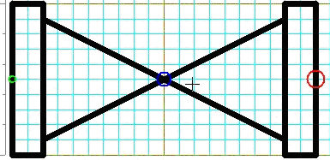
Isometric Management
Custom Symbology (cont)
    On the Add New Symbol dialog box, select Create Symbol. This will take you to the graphics-editing environment with the current symbol displayed
    Select Move >Symbol Within Grid from the main menu.
    Click on the intersection of lines that is exactly two units East and one unit North of the small green circle at the left of the symbol
    Select Move >Start Point/End Point from the main menu to relocate points as show (green/red pts)
    Right-click the mouse anywhere on the grid to end the command. Click on the small green circle to being drawing a line. A stretch line will appear. Continue the lines and complete as follows:

Slide 31
Isometric Management
Custom Symbology (cont)
    Select the Done button on the left-hand vertical toolbar. This will save your edits to the symbol
    Select File >Save As from the main menu and save the symbol library file to:
    [Symbols Share]\PmfgIsoStyleData\Symbol.asc (A Symbol.bin file is automatically created). Exit editor
    Edit Options for the Iso_Pipeline style in Unit01
    From the Options Browser, select Supplementary.DataFiles
    Click in the right-hand pane and press the Insert key to insert a row in the collection
    Select the dropdown in the DataFileType column and select ASCII-SYMBOLS
    Click on the browse button in the FilePath field and enter the full path to the symbols file
    Save your edits to the catalog and exit the Options Browser
    Extract pipeline 1001-P and review the gate valves

Slide 32
Isometric Management
Change Management
    Change Management on a piping isometric drawing refers to the fact that the same information needs to appear on the same sheet of an isometric drawing each time you extract the drawing.
    Edit Options in the User Iso Pipeline style in Unit01C
    Set Drawing.Content.ChangeManagementEnabled option to True
    set the Drawing.Controls.PipeLineSplitting option to 90 (%) to leave room for growth in the drawing content area
    To handle material list overflows from sheet to sheet without breaking change management, use isometric option settings:
      MaterialList.MaterialListOverflow to Continuation Sheet
      MaterialList.OverflowDrawingID to Alpha suffix (e.g: 2A, 3A, etc).
      Set MaterialList.Drw1of1OnSingleIsos to True
    With this done, part items will remain on the same sheet

Slide 33
Isometric Management
Change Management (cont)
    Extract line 1001-P under Unit01C and review sheets content
    Switch to Piping task and model 2 new branches with components on line 1001-P
    Extract line 1001-P under Unit01C again and review sheets content
    All items that were extracted previously should appear on the same sheets
    New piping items modeled should appear on existing sheets in previously clear spaces or in newly created sheets

